Slide 1

Lecture
on
“Advanced Computer Architecture –TCS 704”
by
Akansha Gupta
DEPARTMENT OF COMPUTER SCIENCE AND ENGINEERING
GRAPHIC ERA DEEMED TO BE UNIVERSITY – 248002

Slide 2
SET ASSOCIATIVE MAPPING

Slide 3
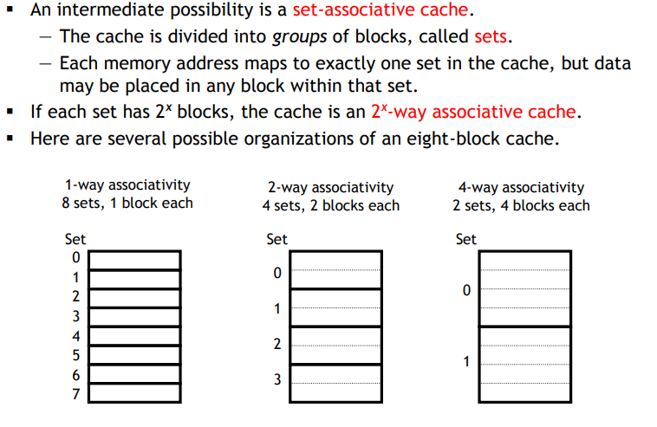
Set associativity

Slide 4
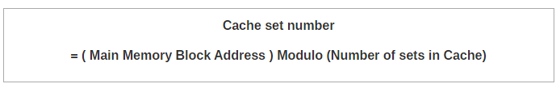
K-way Set Associative Mapping
In k-way set associative mapping,
Cache lines are grouped into sets where each set contains k number of lines.
A particular block of main memory can map to only one particular set of the cache.
However, within that set, the memory block can map any cache line that is freely available.
The set of the cache to which a particular block of the main memory can map is given by-

Slide 5
Need of Replacement Algorithm
Set associative mapping is a combination of direct mapping and fully associative mapping.
It uses fully associative mapping within each set.
Thus, set associative mapping requires a replacement algorithm.

Slide 6
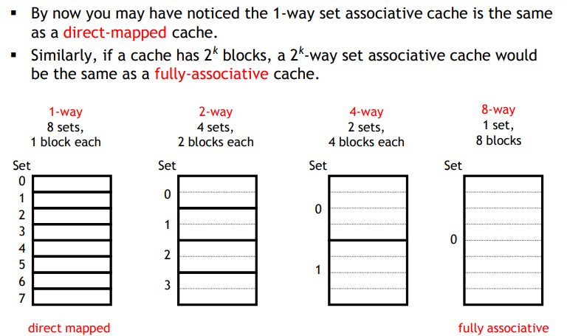
Set associative caches are a general idea

Slide 7
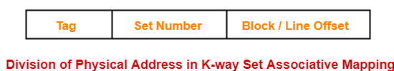
Division of Physical Address
In set associative mapping, the physical address is divided as-

Slide 8
PRACTICE PROBLEMS BASED ON SET ASSOCIATIVE MAPPING

Slide 9
Problem-01:
Consider a 2-way set associative mapped cache of size 16 KB with block size 256 bytes. The size of main memory is 128 KB. Find-
Number of bits in tag
Tag directory size

Slide 10
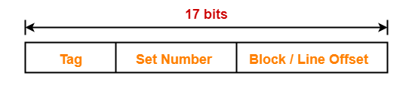
Solution-
Given-
Set size = 2
Cache memory size = 16 KB
Block size = Frame size = Line size = 256 bytes
Main memory size = 128 KB
We consider that the memory is byte addressable.

Slide 11
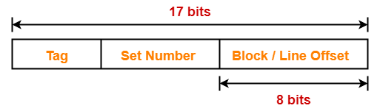
Number of Bits in Block Offset-
We have,
Block size
= 256 bytes
= 2⁸ bytes
Thus, Number of bits in block offset = 8 bits

Slide 12
Number of Lines in Cache-
Total number of lines in cache
= Cache size / Line size
= 16 KB / 256 bytes
= 2¹⁴ bytes / 2⁸ bytes
= 64 lines
Thus, Number of lines in cache = 64 lines

Slide 13
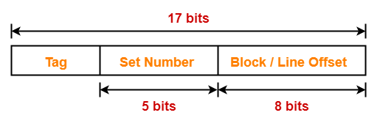
Number of Sets in Cache-
Total number of sets in cache
= Total number of lines in cache / Set size
= 64 / 2
= 32 sets
= 2⁵ sets
Thus, Number of bits in set number = 5 bits

Slide 14
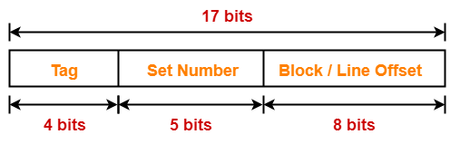
Number of Bits in Tag-
Number of bits in tag
= Number of bits in physical address – (Number of bits in set number + Number of bits in block offset)
= 17 bits – (5 bits + 8 bits)
= 17 bits – 13 bits
= 4 bits
Thus, Number of bits in tag = 4 bits

Slide 15
Tag Directory Size-
Tag directory size
= Number of tags x Tag size
= Number of lines in cache x Number of bits in tag
= 64 x 4 bits
= 256 bits
= 32 bytes
Thus, size of tag directory = 32 bytes

Slide 16
https://youtu.be/d_kQWLgsgws
THANKS

